Slide 1
CS6501/ECE6501 IoT Sensors and Systems
September 18, 2017
Brad Campbell – bradjc@virginia.edu
http://www.cs.virginia.edu/~bjc8c/class/cs6501-f17/

Slide 2
PIPENET: A Wireless Sensor Network for Pipeline Monitoring
Ivan Stoianov, Lama Nachman, Sam Madden, Timur Tokmouline
IPSN 2007

Slide 3
Water pipe leaks contribute to non-negligible water loss
5-10% of potable water produced is lost in transmission
Treated and pumped water that generates no revenue

Slide 4
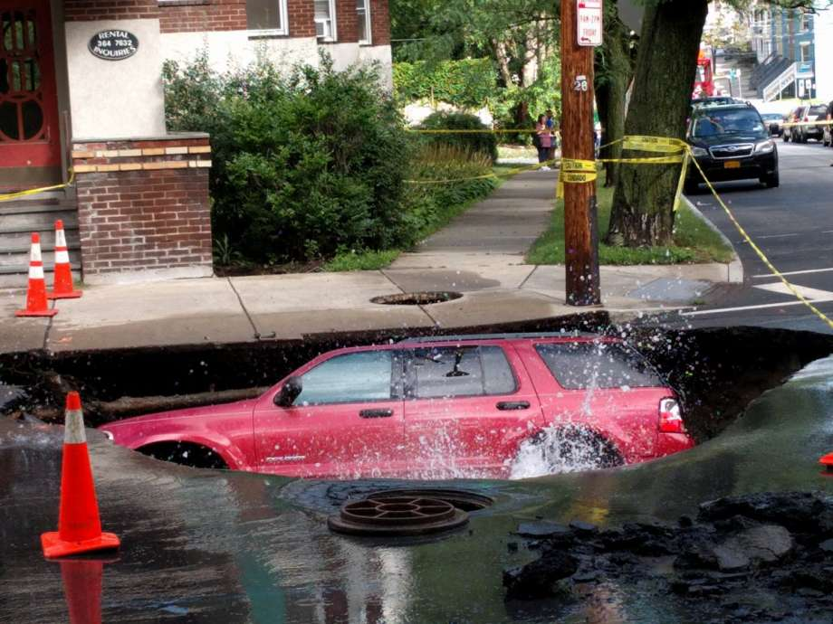
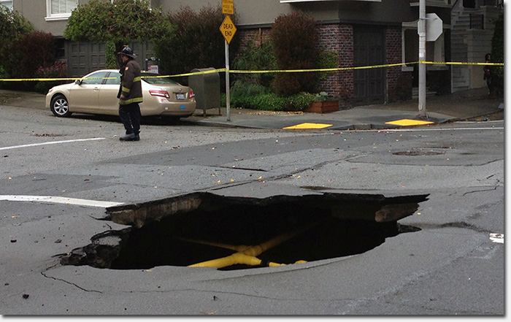

Slide 5
What is their approach?

Slide 6
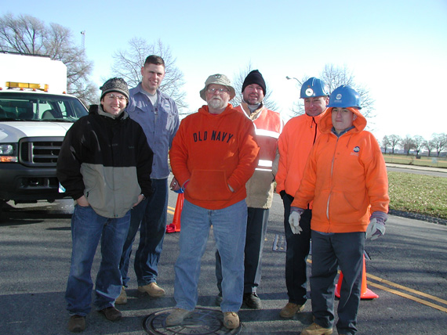

Slide 7
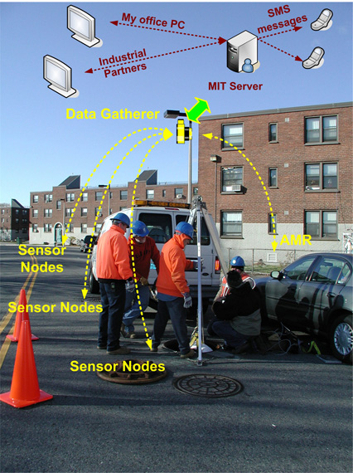

Slide 8
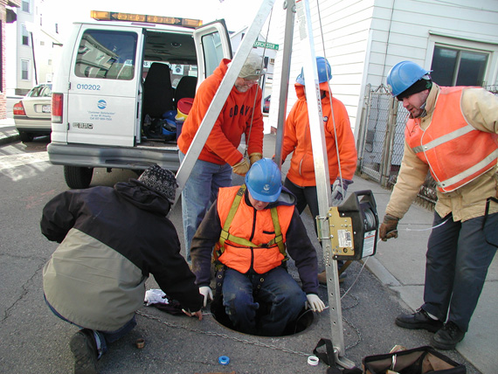

Slide 9
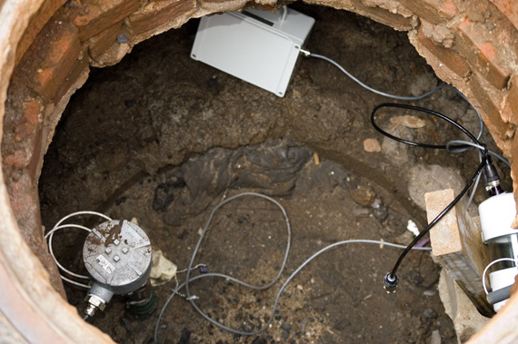

Slide 10
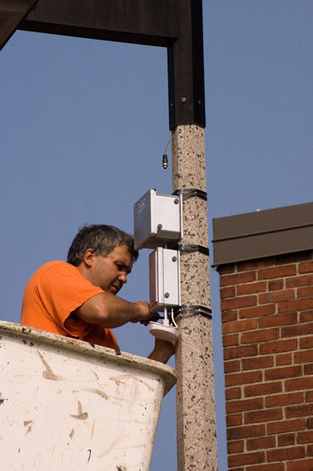

Slide 11
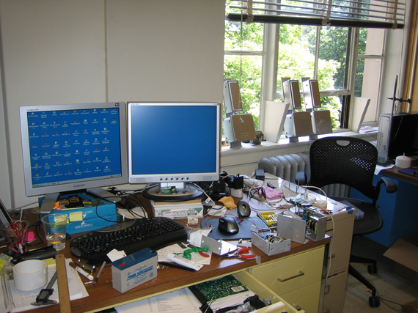

Slide 12
Can they detect leaks?

Slide 13
Real time monitoring?

Slide 14
Sensor lifetime?
“50-62 days”
But, 2 mA sleep current at the time

Slide 15


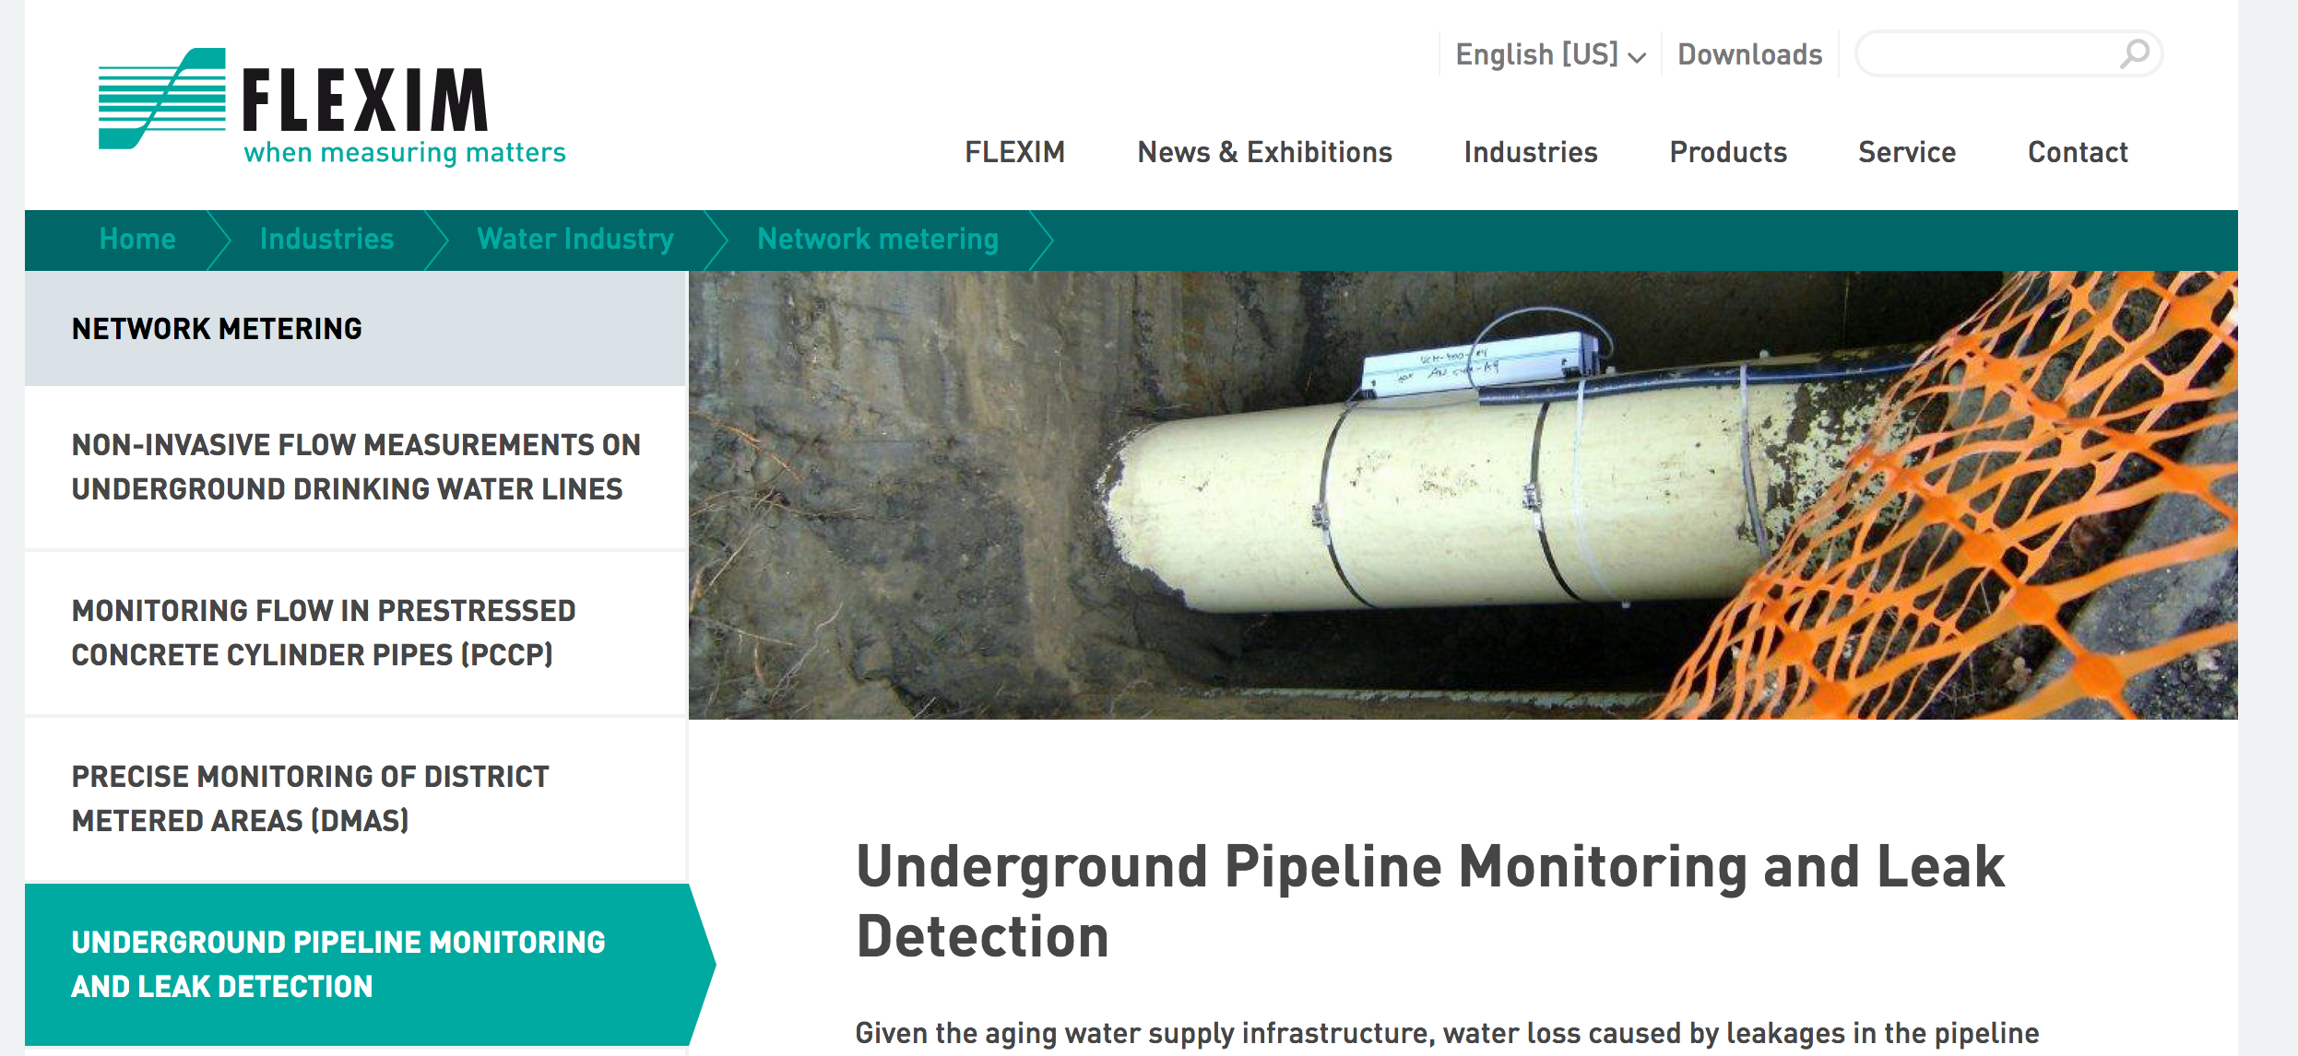
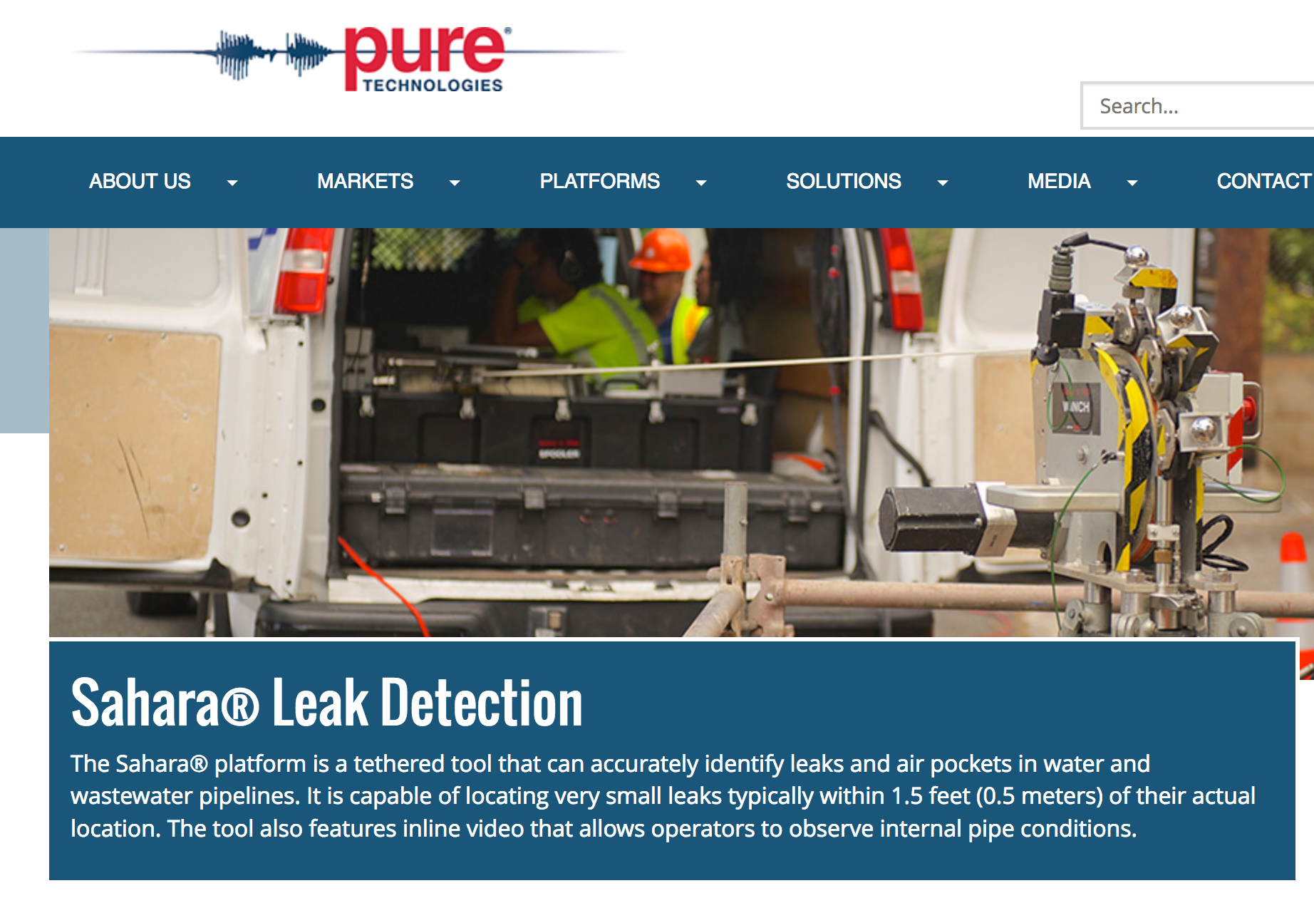

Slide 16
ALPS: A Bluetooth and Ultrasound Platform for Mapping and Localization
Patrick Lazik, Niranjini Rajagopal, Oliver Shih, Bruno Sinopoli, Anthony Rowe
SenSys 2015

Slide 17
Indoor Localization
Multiple categories
Inertial sensors based
Fingerprinting based
Lidar based
Custom infrastructure
Dedicated tags
Existing devices

Slide 18
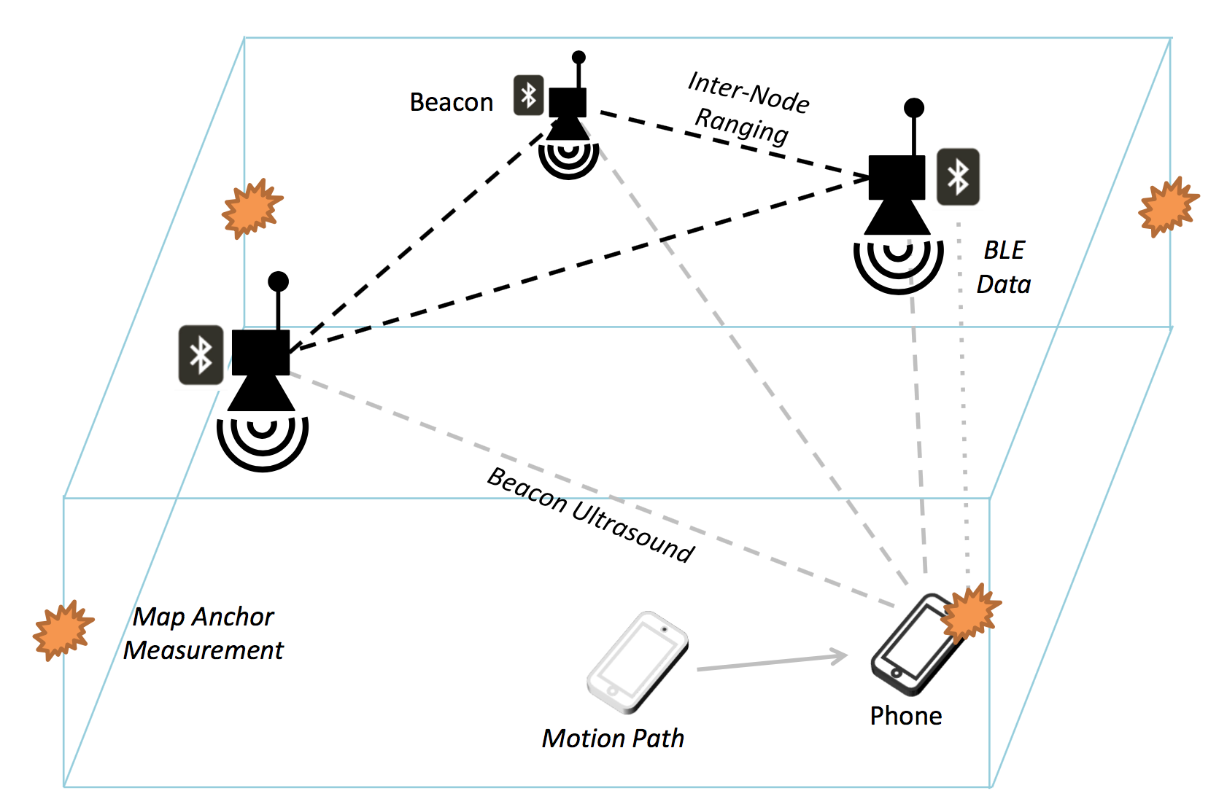

Slide 19
2015 Microsoft Indoor Localization Competition

Slide 20
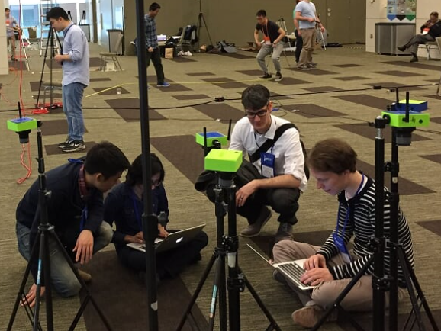
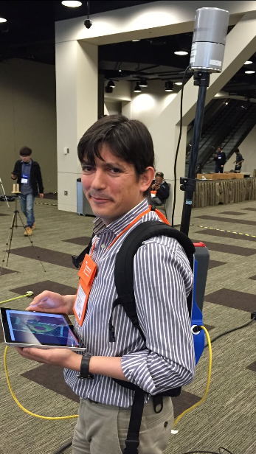

Slide 21
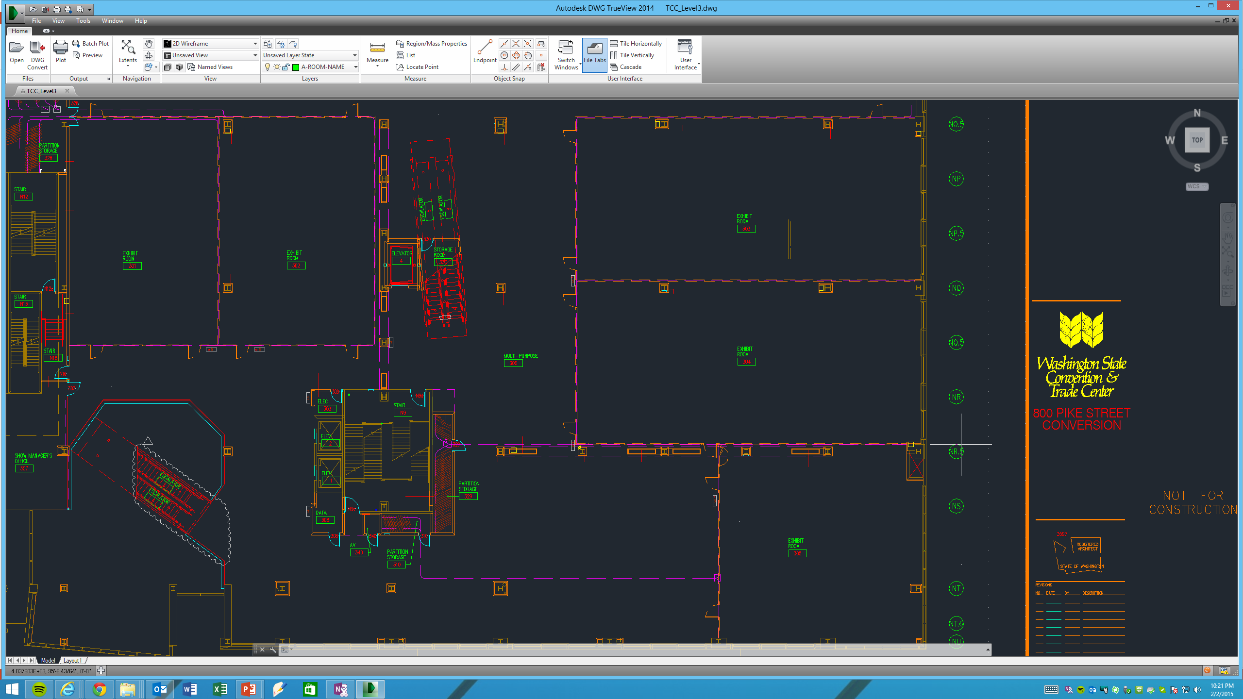
Goal: be accurate at each measurement point
Y Axis
Origin Point
(0,0)
X Axis

Slide 22
Three key challenges
Accurate localization
Easy setup
Handle non line-of-sight cases well

Slide 23
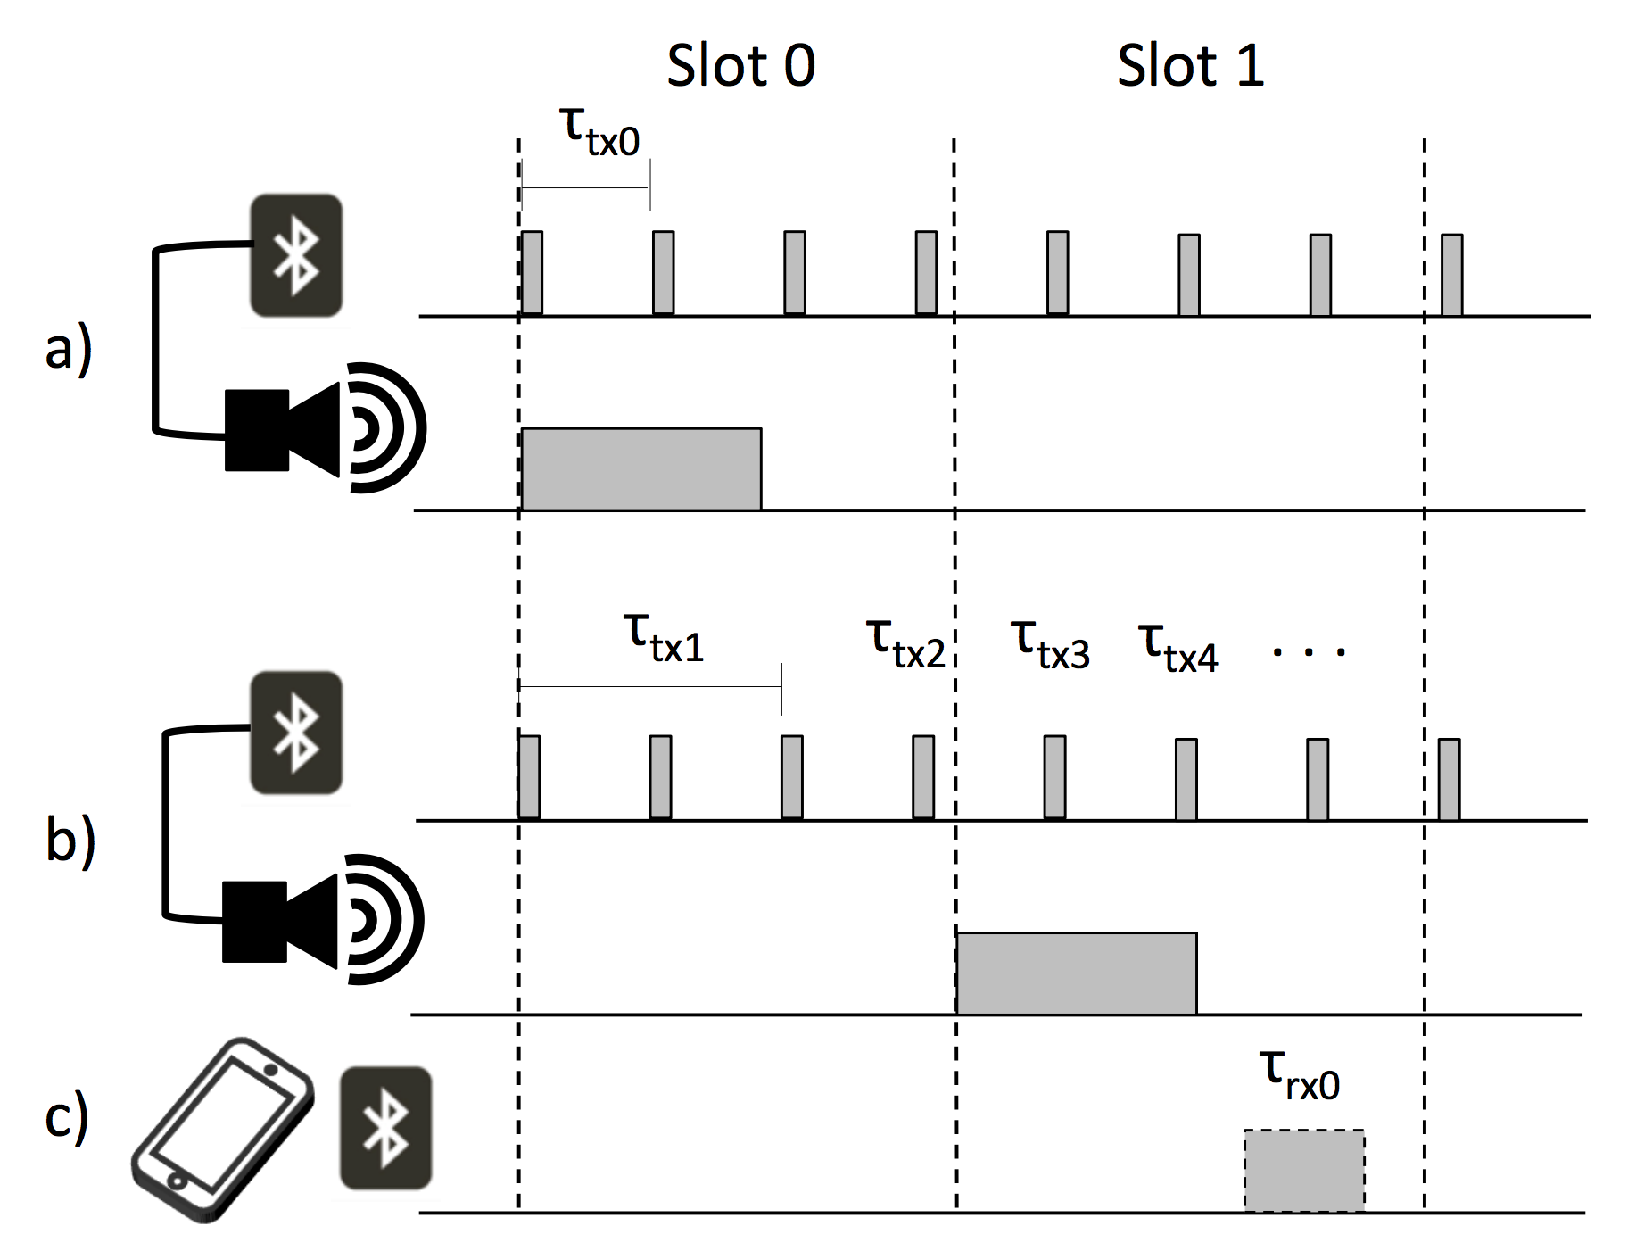

Slide 24
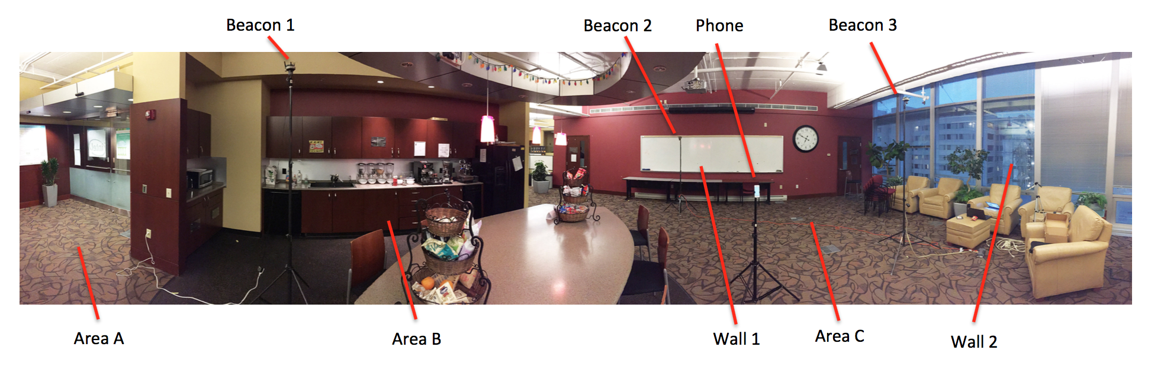
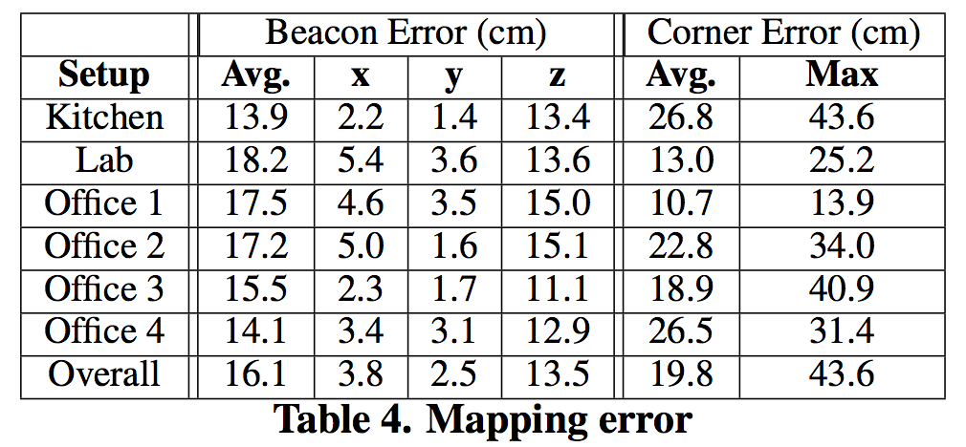

Slide 25
How good is good enough?

Slide 26
Tradeoff between usability, deployment, accuracy, cost, reliability

Slide 27
Project papers
2 pages, bring two copies to class next Monday (September 25, 2017)
Should convey:
What is your idea? Why is it important? Who will care if it succeeds?
What is your hypothesis?
What other approaches exist? Why are they insufficient?
Some related work.
What might the design for a solution look like?
Any format, but eventually will need to be in acmart.cls

